Slide 1
Paint
Acrylic Fallen Leaves
Untitled I and II
Abstract
Mixed Media Cherry Tree

Slide 2
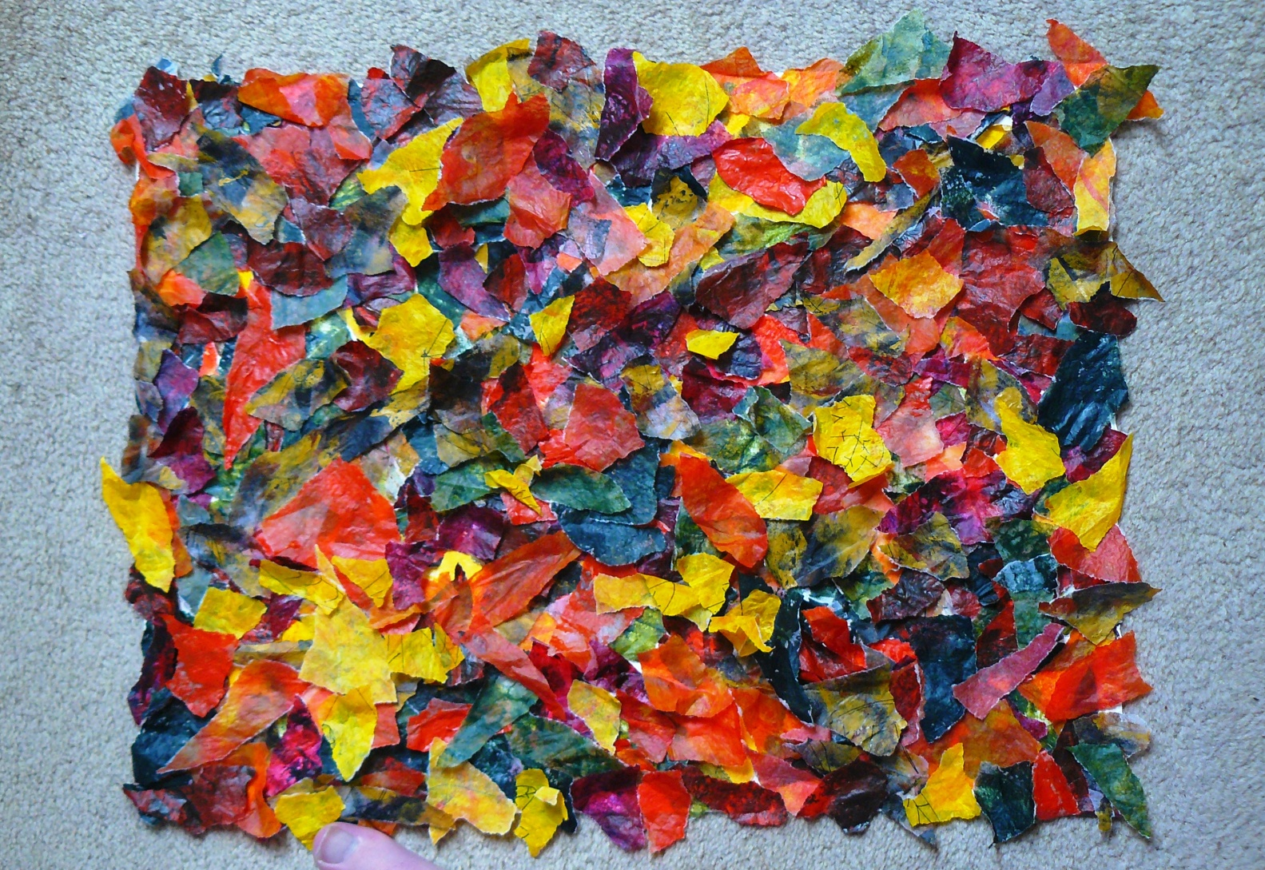
Fallen Leaves Acrylic on tissue paper on 300gsm watercolour paper

Slide 3
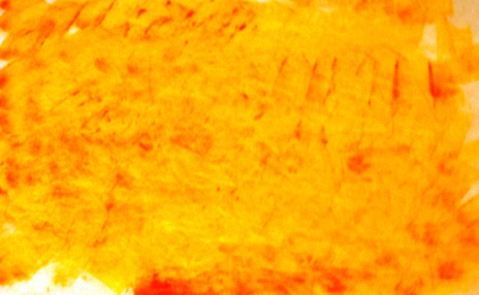
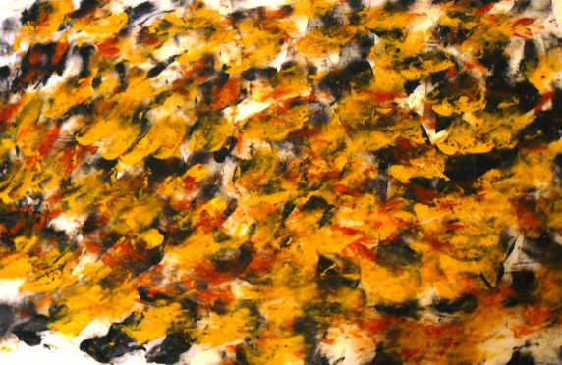
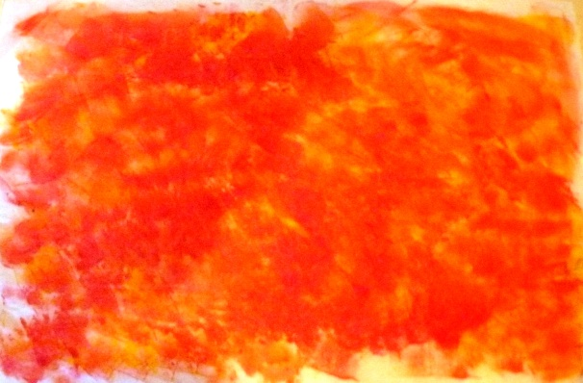
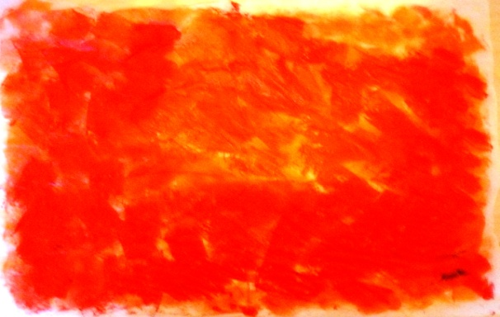
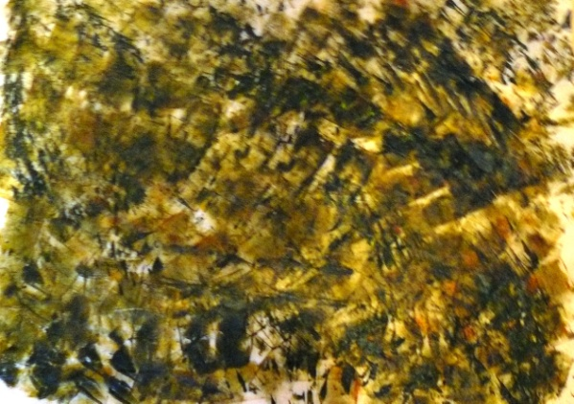
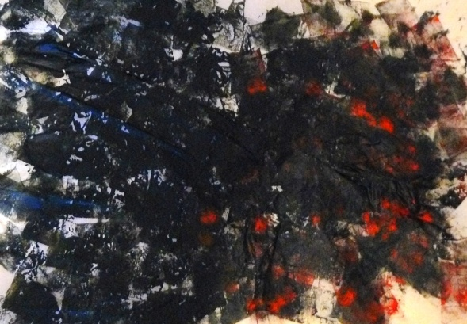
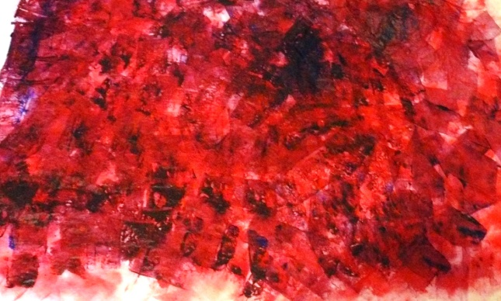
I applied thick layers of acrylic paint onto sheets of tissue paper, applying the paint with a sponge to give a printed effect. I used tissue paper because of its lightness and translucency. I applied between two and three layers of thick paint to each sheet of paper to give a textured effect. The paper crinkled under the weight and dampness of the wet paint and helped create the effect of damp leaves. Below are the seven pieces of painted tissue paper I used to create the final piece.

Slide 4
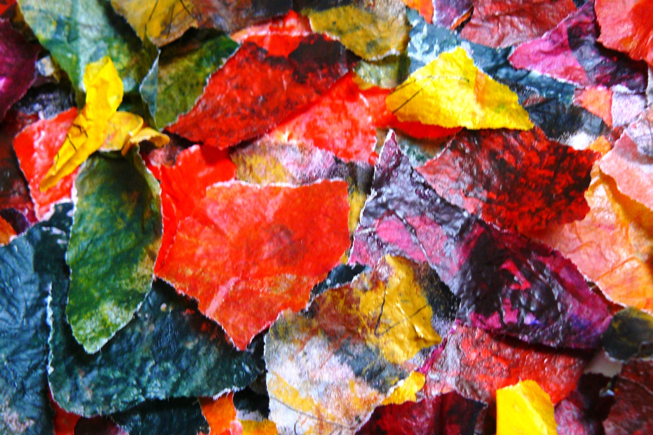
Once the paint had dried it gave the paper a stiff, shiny and slightly waxy texture. I tore up the paper at random into pieces between 2cm² and 4cm² and glued them to the paper at random but ensuring I had a more-or-less equal distribution of colour. I did not want the collage to look too organised. I stuck down only a small area of each ‘leaf’ so that they would curl upwards and catch the light.

Slide 5
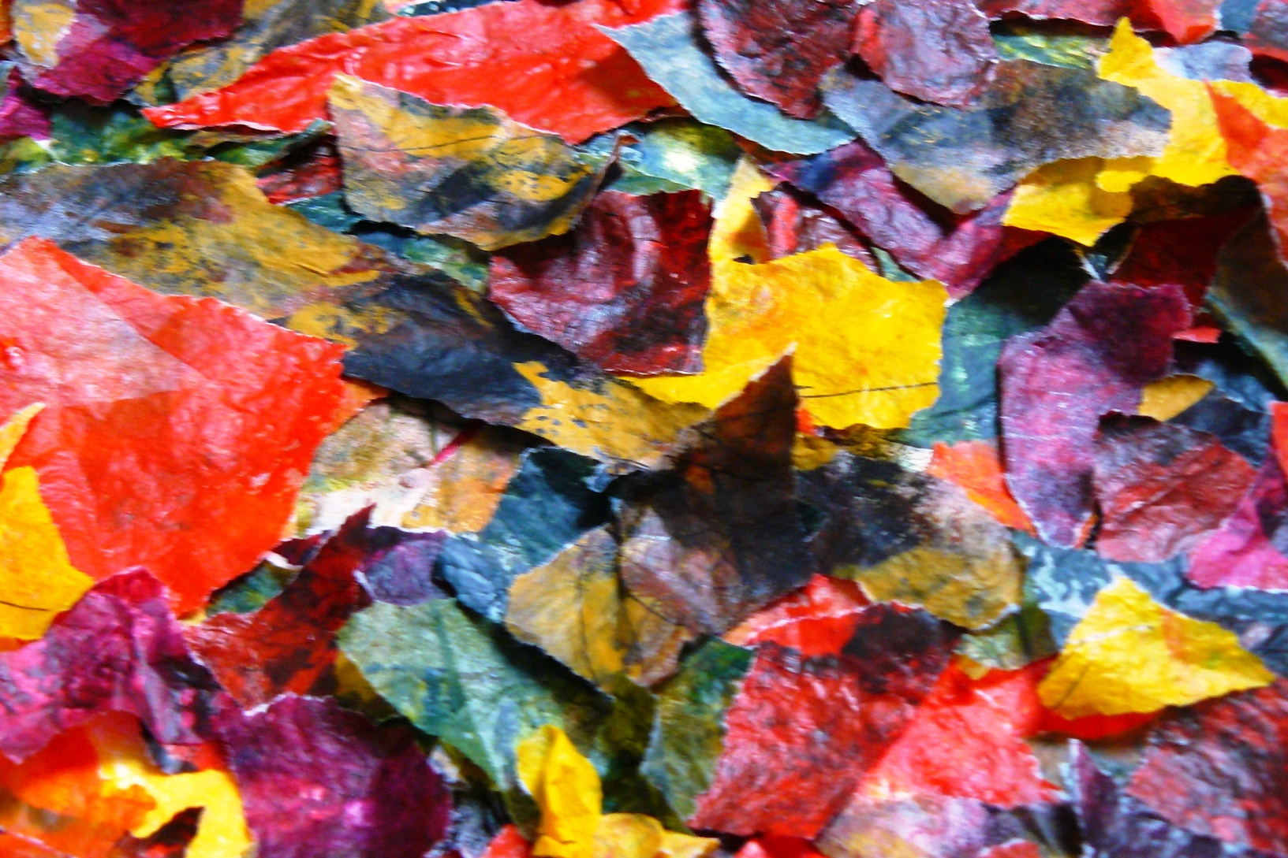
Fallen Leaves Detail

Slide 6
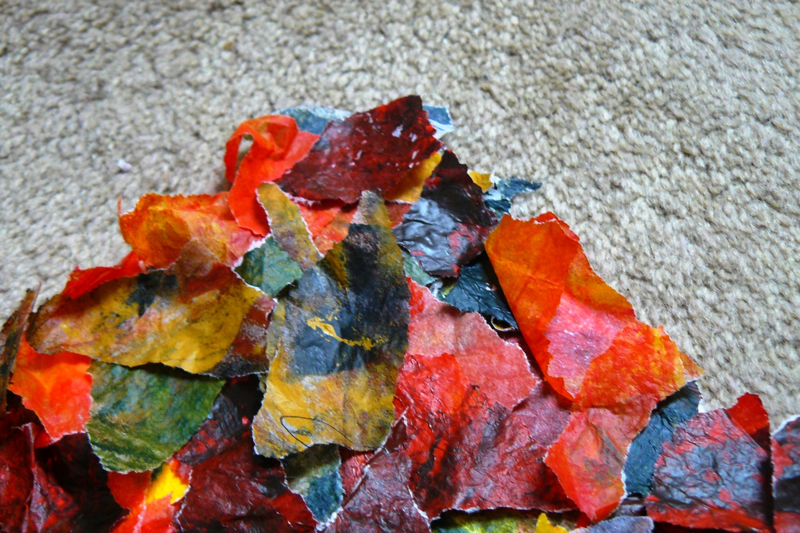
Fallen Leaves Detail

Slide 7
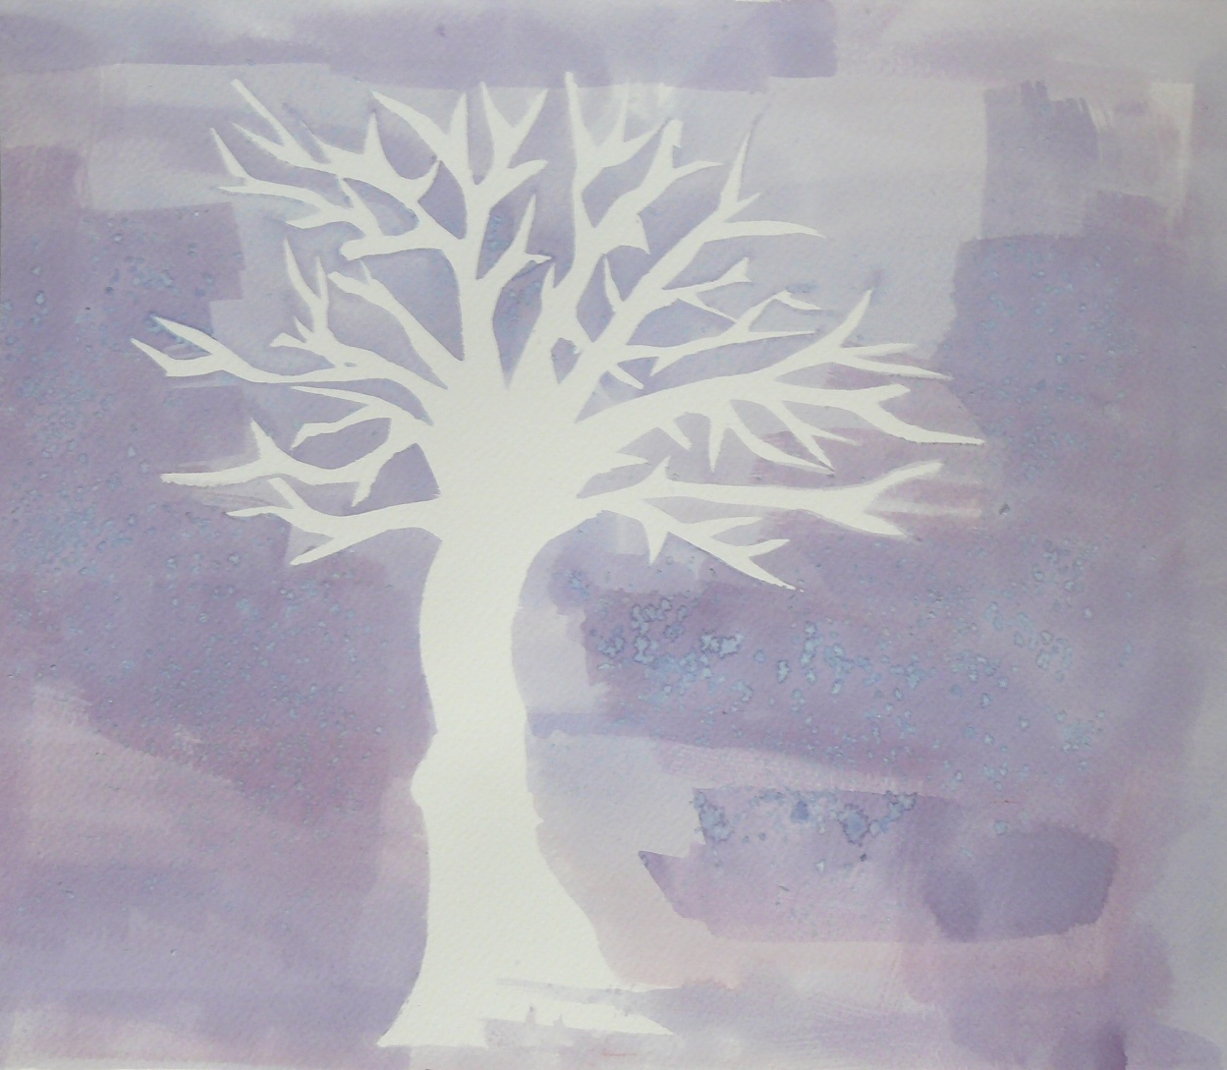
Cherry Tree Clipper Berry Tea Sea salt 300gsm watercolour paper

Slide 8
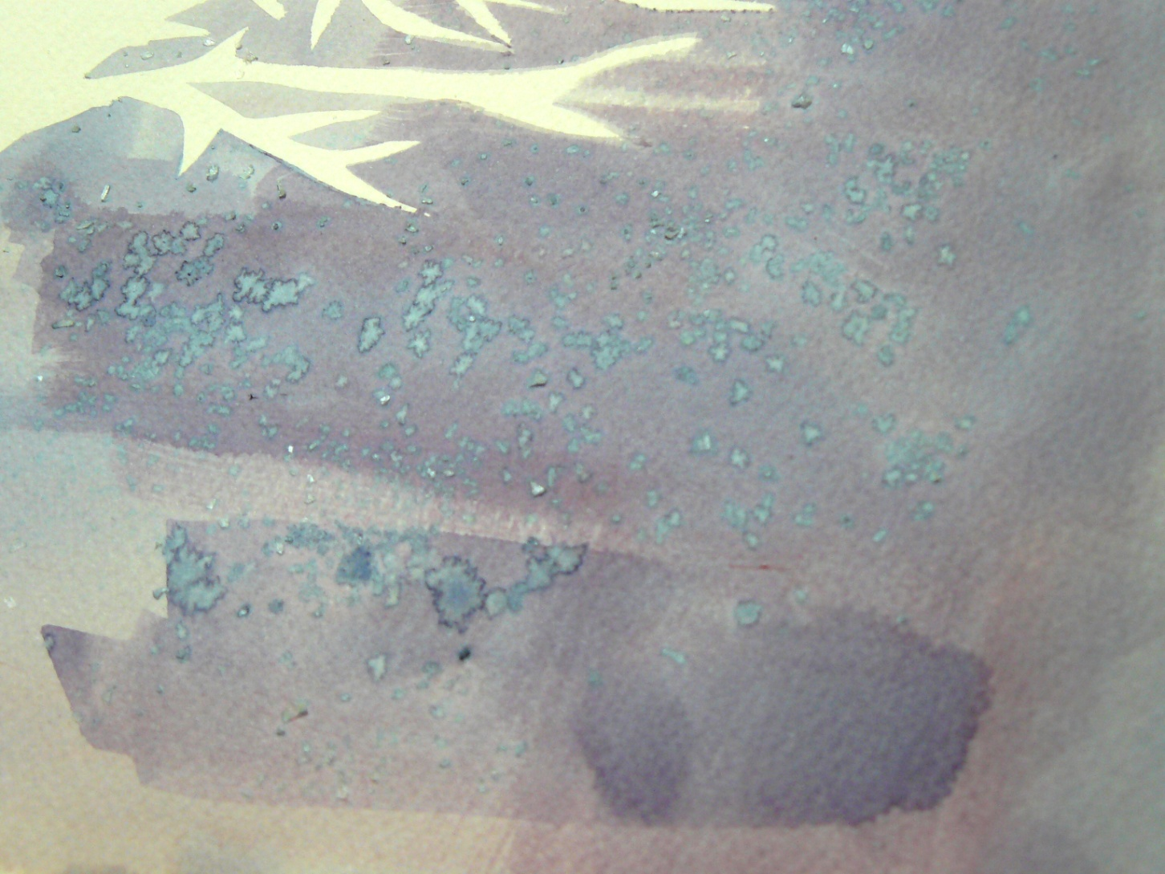
Cherry Tree Detail – sea salt

Slide 9
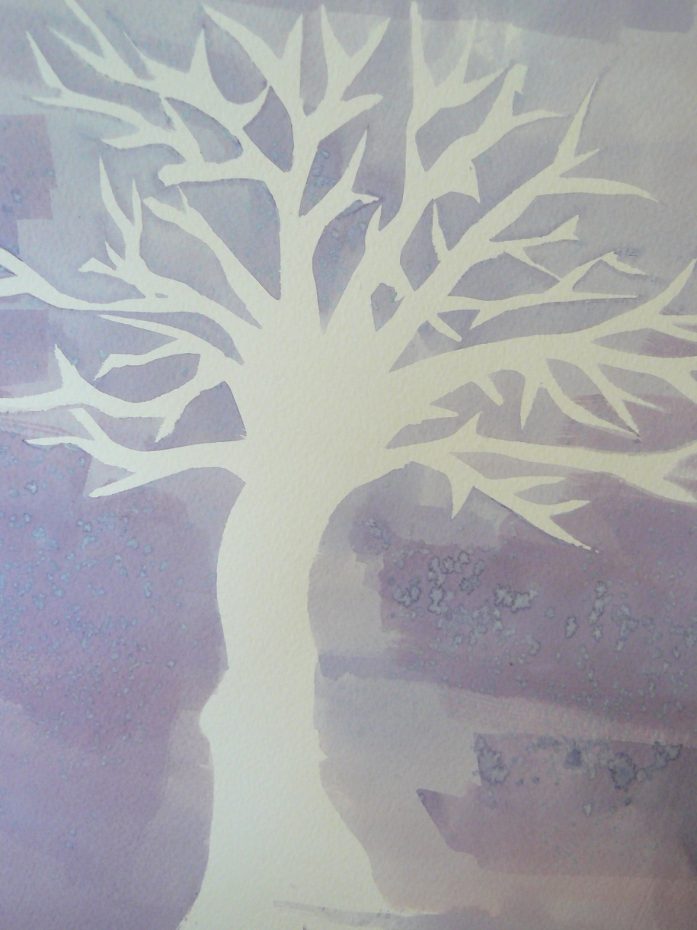
I wanted to create a piece which focused on negative space.
This piece was informed by my idea that nature has been portrayed in so many ways by artists; this piece portrays nature by specifically not portraying it - the negative space creates the impression of a tree.
My decision to use a tree as the subject matter was to highlight the connection between the tree and the paper.
I used unconventional media: strongly brewed berry tea and salt. This was partly to adhere to the theme of ‘nature’ within the piece and partly because I was curious to see how tea would behave when used like watercolour paint.
I painted over a hand drawn template of a tree, then applied the wash of tea. The tea dried darker in some places than others, which I liked because it drew attention to the blankness of the negative space. I sprinkled salt onto the tea and left it overnight to give a blotchy effect which I intended to look like cherry blossom.

Slide 10
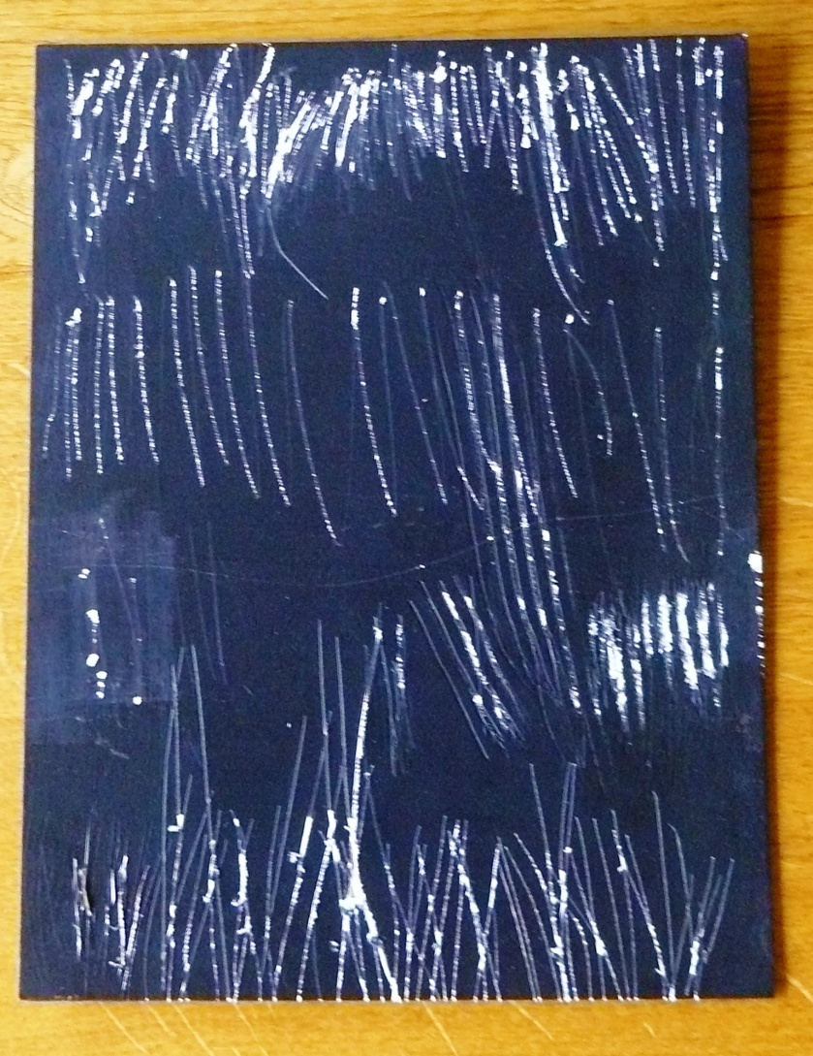
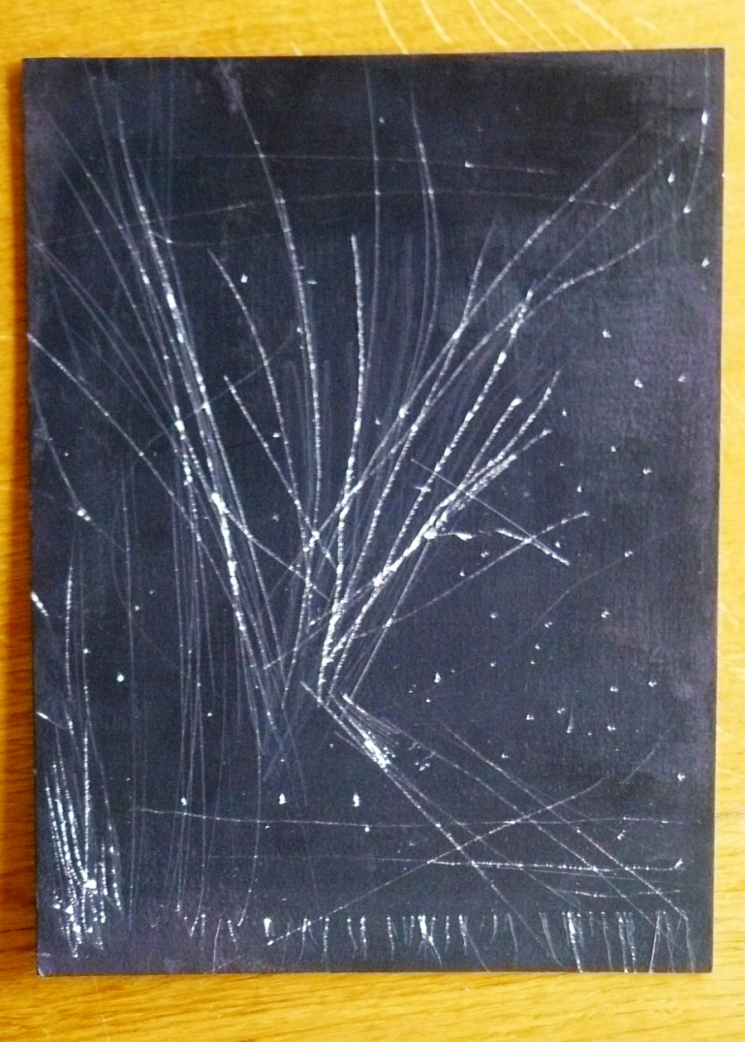
Untitled I and II Acrylic on watercolour board

Slide 11
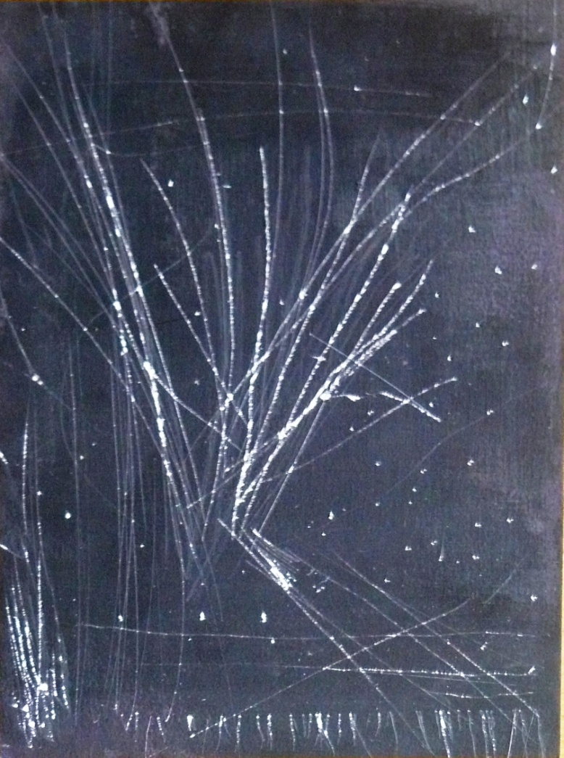
Untitled I detail
These pieces were created by scraping marks onto a board which I had painted with acrylic paint.
These pieces were an experimentation - I had initially intended to apply more layers of paint to the dark base, but, inspired in part by Scraperfoil kits, I decided to apply the same principles (scraping the surface to create a picture) to my work. Although these pieces are abstract I feel that Untitled I resembles a tree in snow and Untitled II resembles a field of grass.
I tried various types of sharp objects to make the marks and found a pair of safety scissors worked best – the thick edges made stronger indentations. I scored the length of the blades across the board to create a textured effect, then scored the ends of the blades across the board to create the lines. I dug the ends of the blades into the board to create the speckled effect.

Slide 12
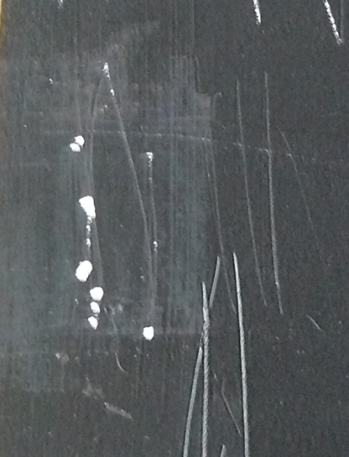
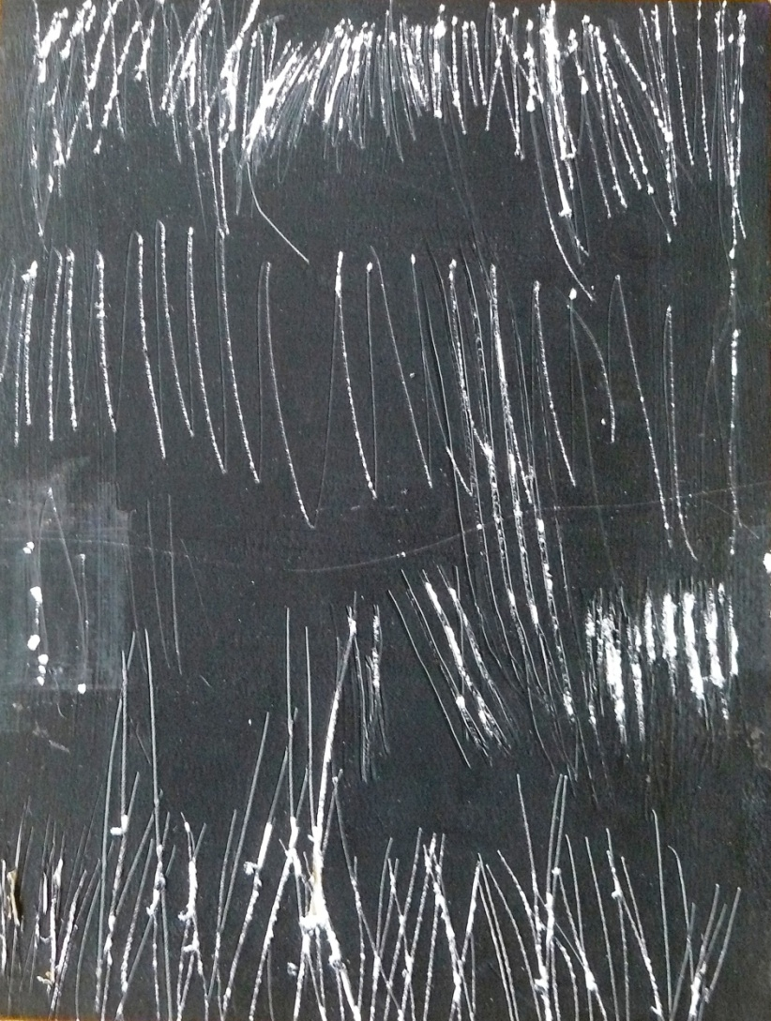
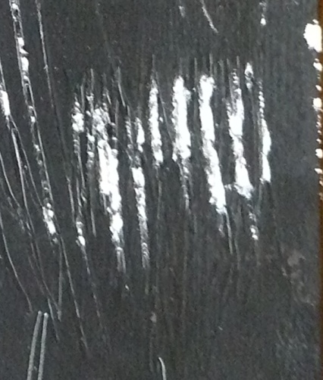
Untitled II detail
To make Untitled II I made a series of short sharp marks with the end of the scissors. In places I have peeled back the paint to expose the board (above right). I used the length of the blade to scuff the paint (below right).

Slide 13
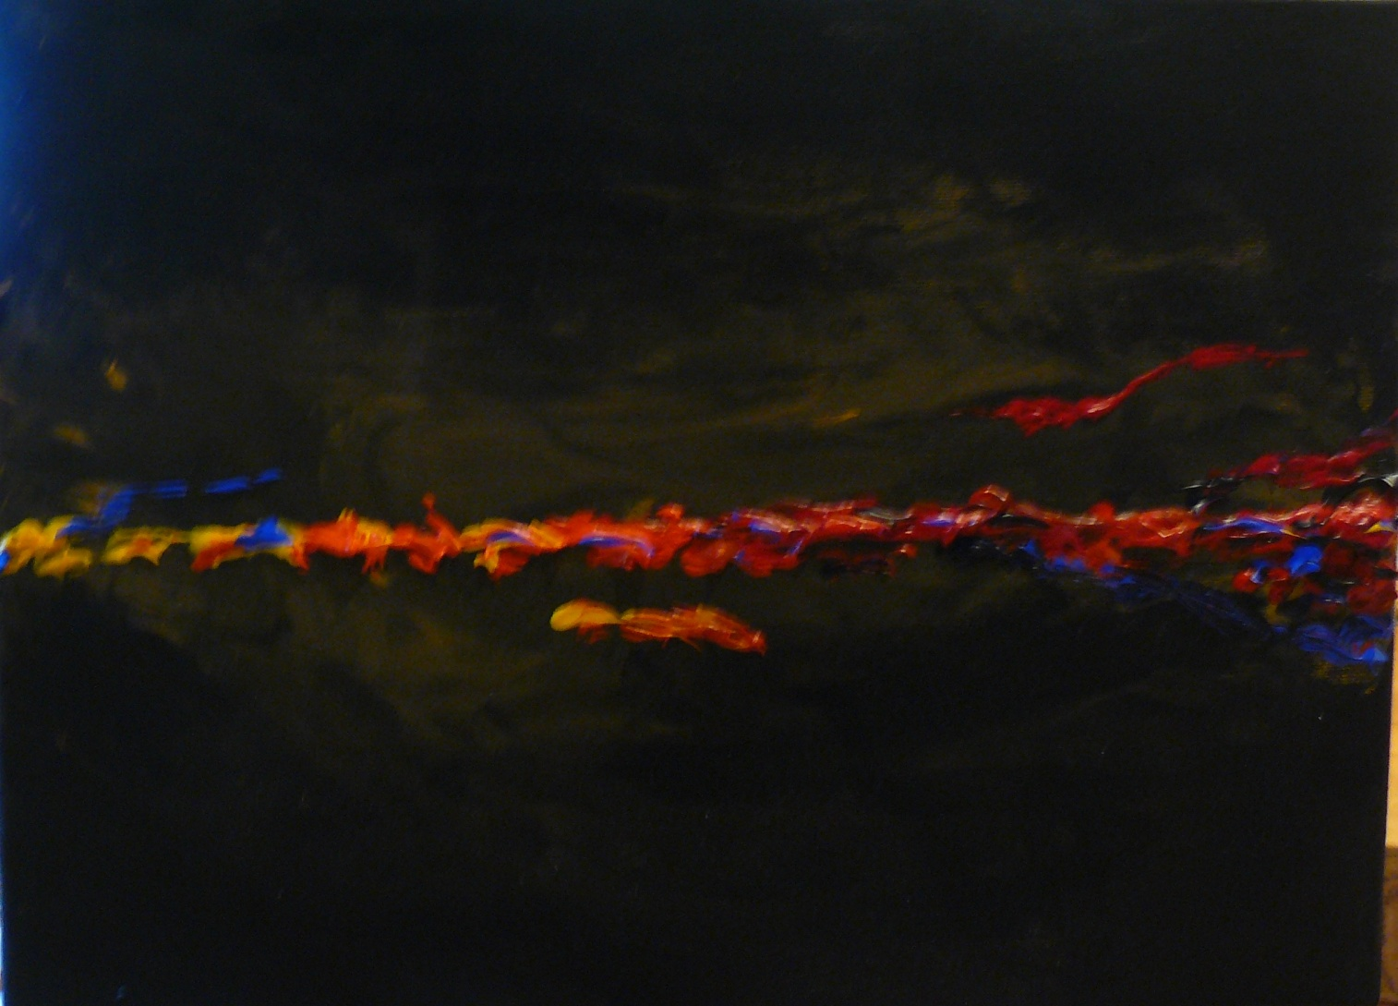
Abstract acrylic paint on canvas

Slide 14
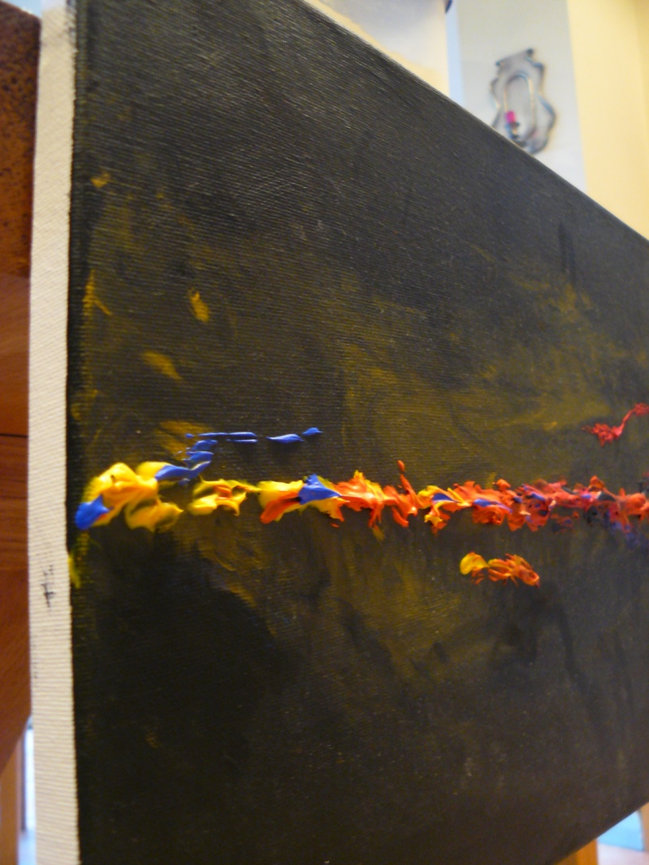
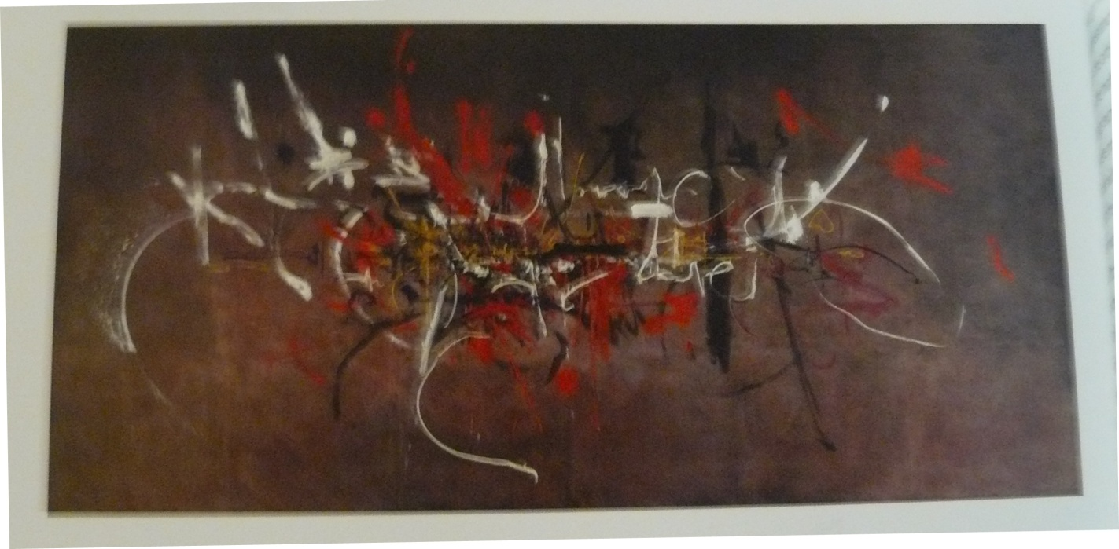
Abstract, detail
This painting represents my own attempt to replicate the ideas behind Abstract Expressionism. it represents a departure from traditional form; it has no subject matter in order that its audience can decide for themselves what it portrays. It is not, however, an entirely organic creation: I planned to juxtapose a line of bright colours across the middle of the canvas with a dark background. The background is inspired by the smooth blended background of Georges Mathieu’s Capetians Everywhere (below). To achieve this I painted the entirety of the canvas in acrylic in mars black and worked yellow ochre into the black with my fingers while it was still damp to create a sense of swirling movement. To create the centre line I mixed ‘Liquitex Matte Super
Heavy Gel’
with varying
quantities of
acrylic to give
the paint a
Stiff texture
which would
Set and allow for greater definition of texture.
Colours: I used ultramarine,
cobalt blue, crimson, cadmium red,
cadmium yellow and burnt sienna in varying quantities.

Slide 15
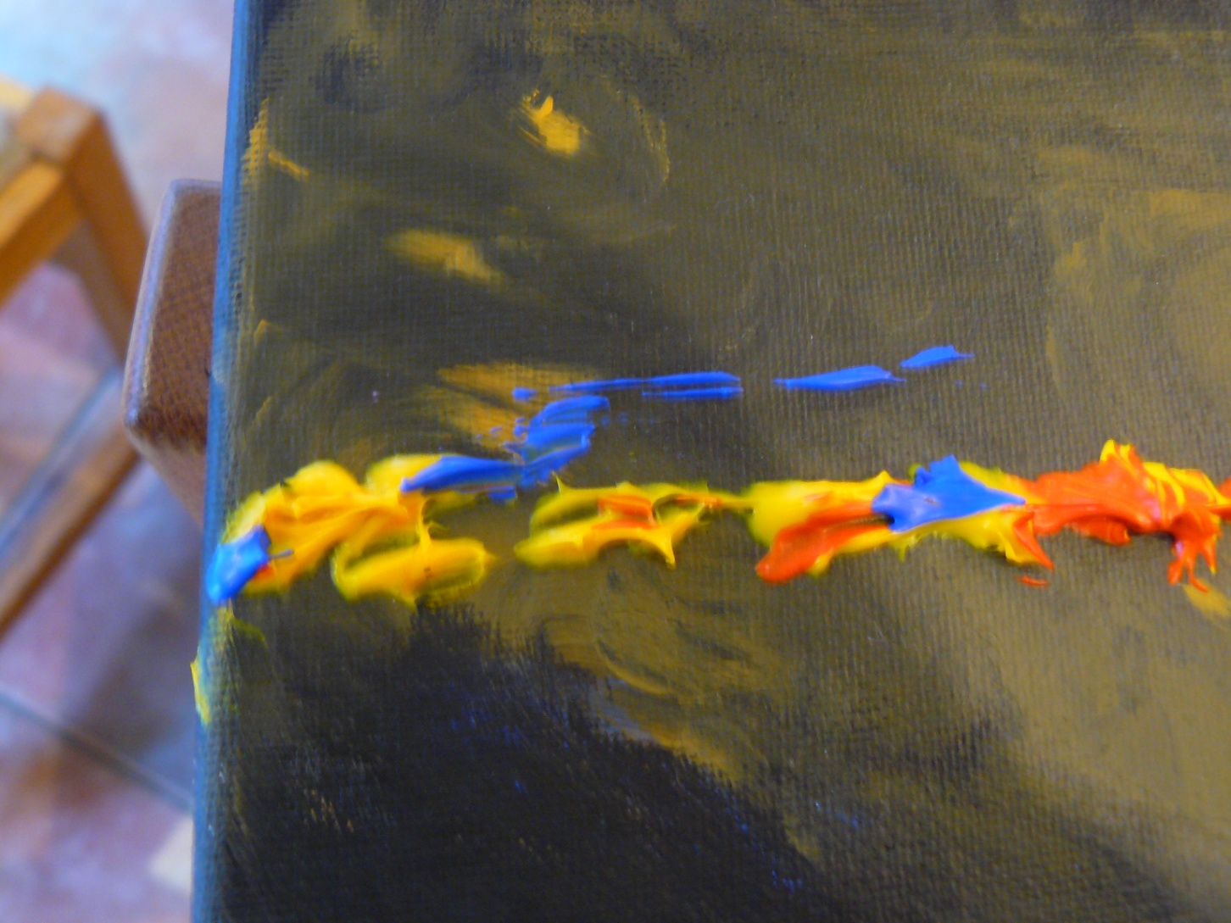
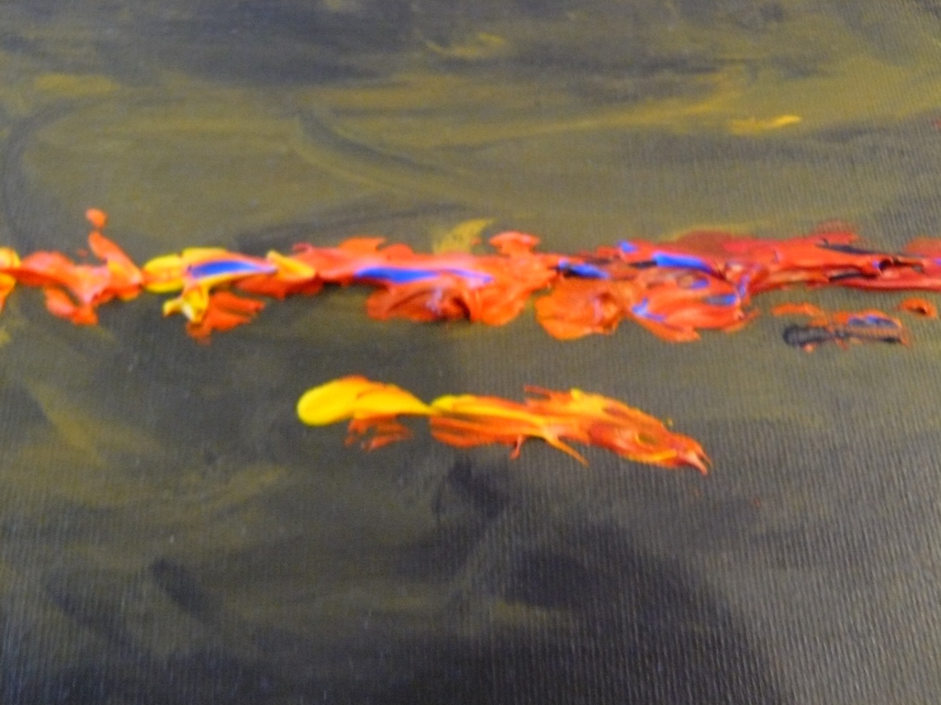
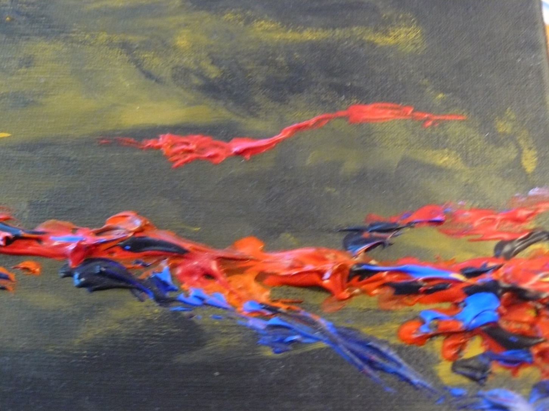
I used the techniques described above in order to create a painting that was very striking. I feel I have achieved a vast amount of depth by blending the background into the canvas and making the centre line three dimensional. The peaks and grooves in the paint can be felt with the hands, which brings the painting to life.
Above right: detail, left side
Below Right: detail, right side
Below: detail, middle

